Slide 1
The case
There is a study related to ASD and comorbidities in Saudi Arabia, and I quote: “The correlation between comorbidities and increased health care utilization shows that the primary care hub-and-spoke model for health care can be effective in screening and subsequently making services accessible to those in most need.”
If we want to manage downstream healthcare demand, we need visibility upstream, starting with early screening.
Reference
The research:
Almai, A., Salpekar, J. A., AlOtaibi, A., Altayeb, J., Muschcab, H., & Alhabib, A. (2026). Health care utilization of children with autism spectrum disorder and comorbidities in Saudi Arabia. Journal of Pediatric Neuropsychology.‏ https://psycnet.apa.org/fulltext/2027-71450-001.html
Data set:
Publicly available autism screening dataset from Saudi Arabia. https://www.kaggle.com/datasets/asdpredictioninsaudi/asd-screening-data-for-toddlers-in-saudi-arabia?utm_source=chatgpt.com

Slide 2
Business requirements
My business requirements and needs are to find:
Identify children who may require further ASD assessment
Prioritized on three criteria: Data availability, Screening Score, and Screening classification.
The KPI most likely to change the assessment outcome.
Toddler → Q-CHAT-10 ) Quantitative Checklist for Autism in Toddlers) → Score → Classification → Further Assessment

Slide 3
Data Dictionary & Data Understanding:
I used the source data dictionary to understand the available fields and their clinical meaning, then standardized the dataset for reporting
Screening Score | Class
0–3 | 0 = No ASD traits
4–10 | 1 = ASD traits

Slide 4
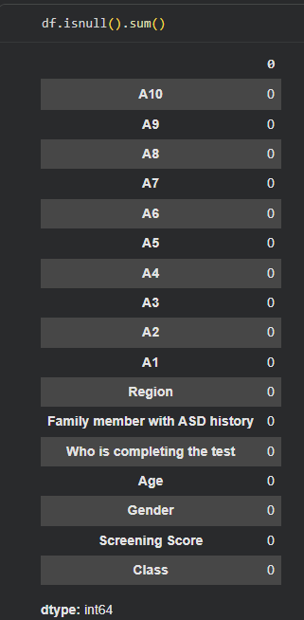
Data validation
20XX
20XX
BS, Aasha University
20XX
Lake Agate High School
20XX
AMA CPM certification

Slide 5
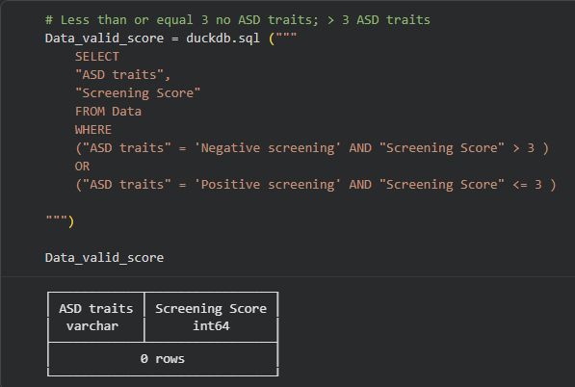
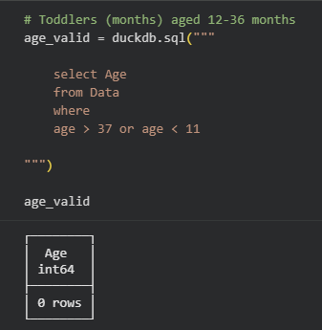
Data validation (SQL)
20XX
MBA, Aasha University
20XX
BS, Aasha University
20XX
Lake Agate High School
20XX
AMA CPM certification

Slide 6
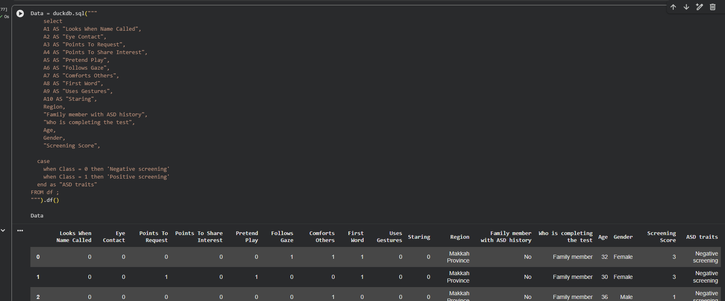
Data Transformation
20XX
20XX
BS, Aasha University
20XX
Lake Agate High School
20XX
AMA CPM certification

Slide 7
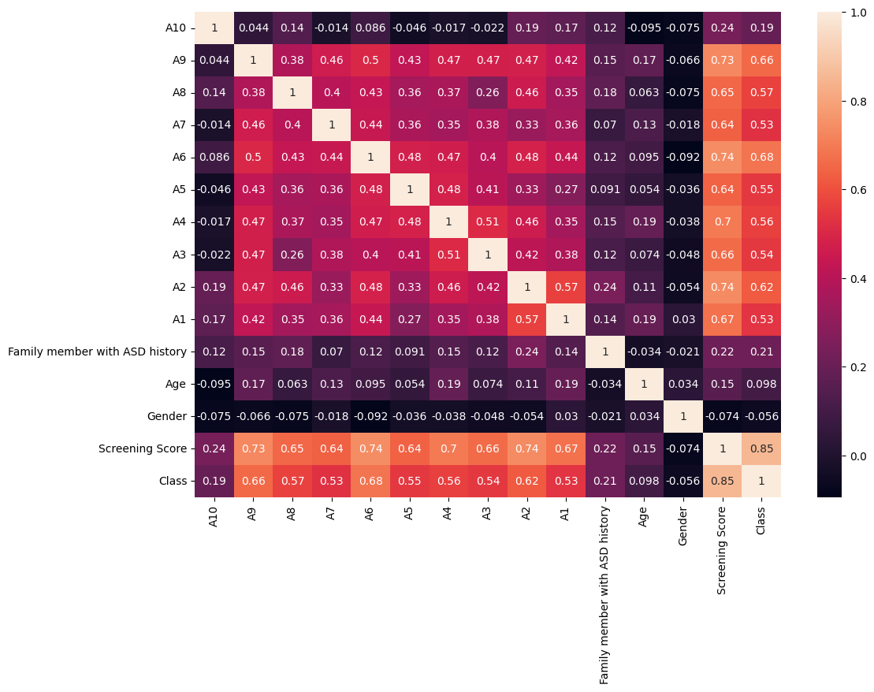
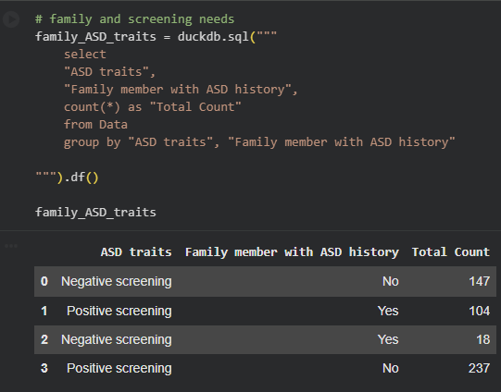
Data Correlation
20XX
20XX
BS, Aasha University
20XX
Lake Agate High School
20XX
AMA CPM certification

Slide 8
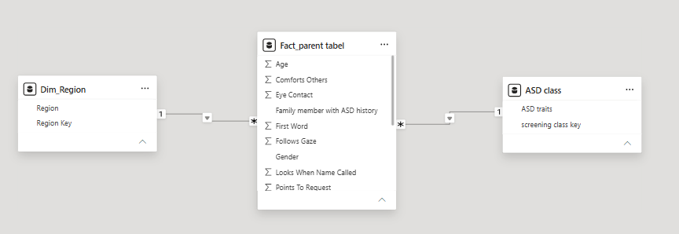
Data Model:

Slide 9
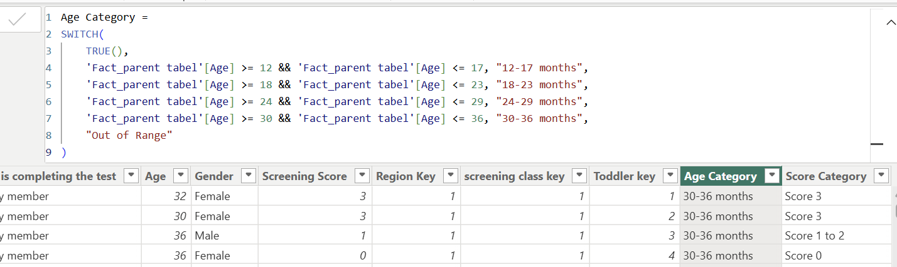
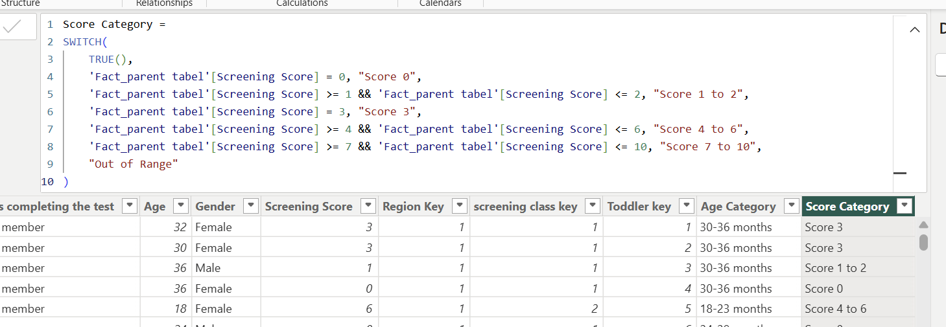
Data Calculation:

Slide 10
KPI
The organization needs to monitor the effectiveness of the early ASD screening process.
Screening volume
Positive screening total
Positive Screening Rate
Negative Screening total
Average age per month that got a positive Screening
(Which groups show different screening patterns) Based on age and the score they achieve

Slide 11
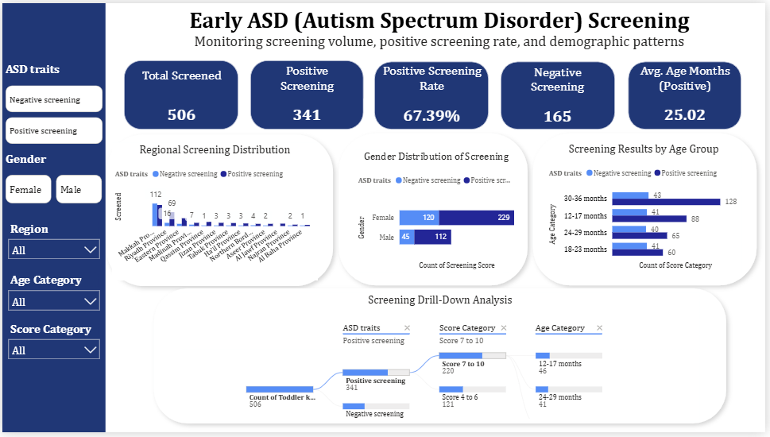
Reporting and Analysis:

Slide 12


Impact:
Score/age cross-tab shows the 30–36-month band carrying the highest count of 7-10 (high-trait) scores.
Avg. age at positive screening is 25.02 months; roughly 11 months remain in the 12- 36-month window, so how quickly a child moves from screening to assessment matters a lot.
67% positive rate (341/506) is well above general-population ASD-trait base rates.
This is exactly the kind of early screening the study points to: catching ASD traits and related risks early enough to connect children with the right care before their needs become more serious.

